Slide 1
<INSERT THE NAME OF YOUR SCHOOL HERE>

Slide 2
HOW DID YOU TRAVEL TO SCHOOL TODAY?
Notes:
Let’ start with a question: How did you get to school today?
Put your hand up if you travelled by car or bus.
[DEPENDING ON HOW MANY STUDENTS PUT THEIR HANDS UP TEACHER CAN RESPOND BY SAYING SOMETHING LIKE: “OK, SO QUITE A FEW OF YOU.” OR “OK, SO ONE OR TWO OF YOU.”

Slide 3
DO YOU SWITCH OFF THE LIGHT WHEN YOU’RE THE LAST PERSON TO LEAVE A ROOM?
Notes:
Here’s another question:
How many of you always switch the light off when you’re the last person to leave the room?
Put your hand up if you do.
[DEPENDING ON HOW MANY STUDENTS PUT THEIR HANDS UP TEACHER CAN RESPOND BY SAYING SOMETHING LIKE: “OK, SO QUITE A FEW OF YOU.” OR “OK, SO ONE OR TWO OF YOU.”

Slide 4
LOTS OF THINGS IN OUR WORLD NEED POWER TO WORK
Notes:
Why am I asking you these questions? What’s so important about car journeys and lightbulbs?
It’s because they both need power to work.
In fact, all sorts of things do – everything from your mobile phone to the fridges and freezers in the school canteen.
Most of our power comes from burning coal, natural gas and oil, which release greenhouse gasses into the atmosphere.

Slide 5
CAN YOU PREDICT
THE SEASONS WHERE
WE LIVE?
Notes:
Right now, too many greenhouse gasses are trapped in our climate and they are causing it to get warmer.
When the Earth warms, the climate changes.
Our climate is the pattern of weather conditions over many years.
Think about [ENTER THE NAME OF YOUR VILLAGE/TOWN/CITY/] where we live.
You could probably predict the seasons – it’s cold and wet in February in winter and warm in August in summer.
But what happens if that starts to change?

Slide 6
CLIMATE
IS LIKE NATURE’S CLOCK
Notes:
Farmers rely on the climate to grow food, and animals rely on it to move around to find mates and food.
As the climate changes, it might get hot at the wrong time of year meaning it’s harder for farmers to grow crops.
A warming climate also means more wildfires, like in Australia and California, and rising sea levels from melting ice caps.
If climate is like nature’s clock – then climate change can cause it to read the wrong time.
So, what do we do about it?

Slide 7
COP26
THE UNITED NATIONS CLIMATE CHANGE CONFERENCE
World leaders make plans to tackle the problem
Notes:
One way is for world leaders to come together to make important decisions about how to tackle the climate crisis.
In November, the UK will host this year’s meeting in Glasgow in Scotland. It’s called COP26 as it’s the 26th United Nations Climate Change Conference.
COP26 is run by the United Nations and COP means “conference of parties” – in a nutshell, they’re like an assembly, but for every single country on Earth.
Over the years there have been 26 of them. Which is why this year’s meeting is called COP26.

Slide 8
GOING
‘NET ZERO’
BY 2050
At COP26, world leaders aim to make a vital agreement
Notes:
Net zero means finding a balance between the greenhouse gases (like CO2) that an individual or organisation puts into the atmosphere, and those that are ‘taken out’.
In other words, it’s making sure that for all the gases emitted, you are removing the same amount from the atmosphere, making yourself carbon ‘neutral’.
Achieving net zero is necessary if we are to tackle climate change and protect people, the planet and our natural world.
The UK has set a target of being net zero by 2050.

Slide 9
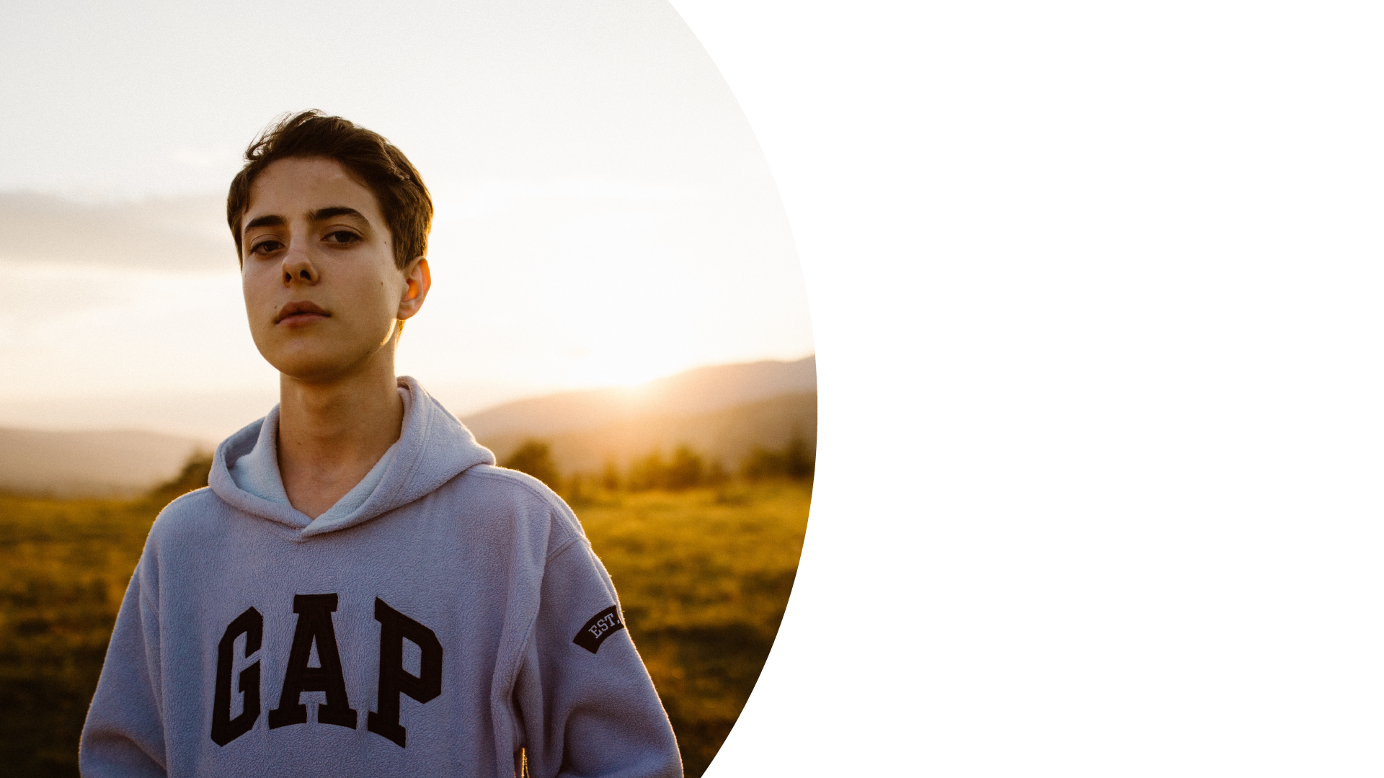
BEING A YOUNG CLIMATE LEADER AND GOING ONE STEP GREENER
Notes:
It’s not just world leaders like our Prime Minister Boris Johnson, or activists who can go one step greener to protect the planet.
Our school and all of you can be Climate Leaders too by incorporating positive environmental actions into our daily lives.
In fact, we already [ADD IN WHAT YOUR SCHOOL IS DOING ALREADY IN THE NEXT SLIDE]

Slide 10
OUR
CLIMATE
LEADERS
Notes:
[ADD A PHOTO OF PUPILS AND TEACHERS DOING THE CLIMATE LEADER ACTIVITIES YOU DESCRIBED OVER THE PREVIOUS SLIDE]

Slide 11
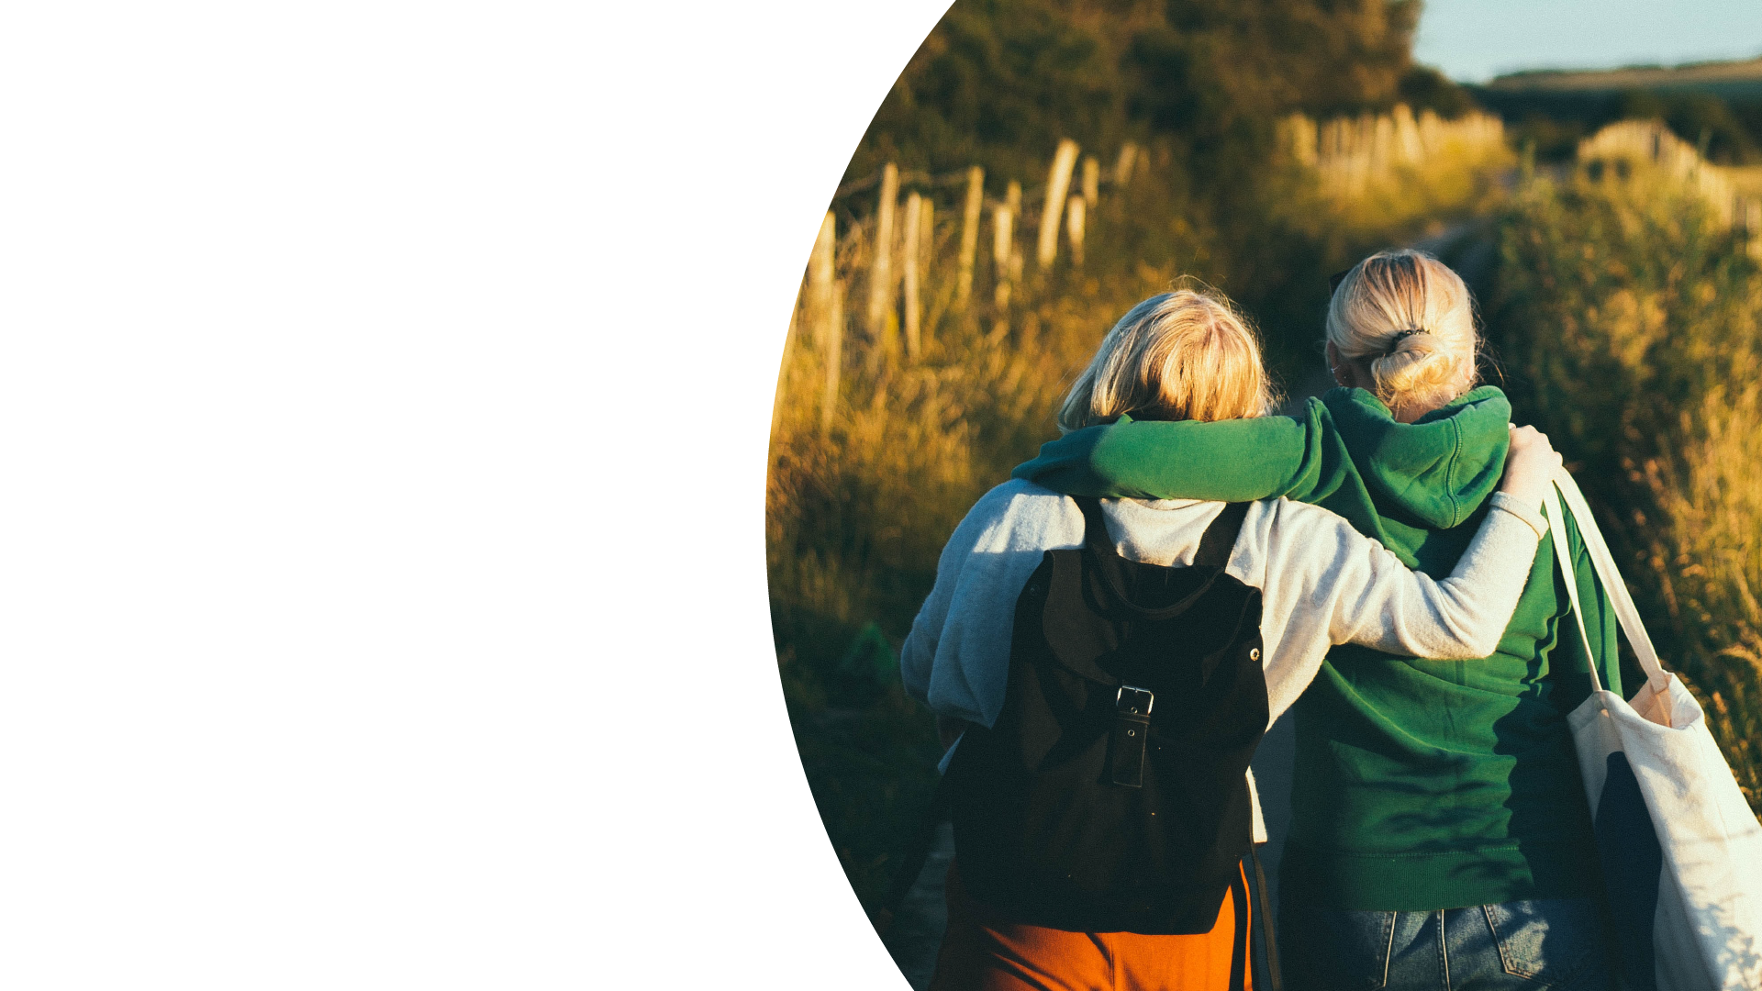
CLIMATE POSITIVE ACTIONS
WALK TO SCHOOL
Notes:
Climate Leaders do all sorts of things, both big and small and there are many things you can do to make a difference.
Things like:
Walking to school if you live close enough

Slide 12
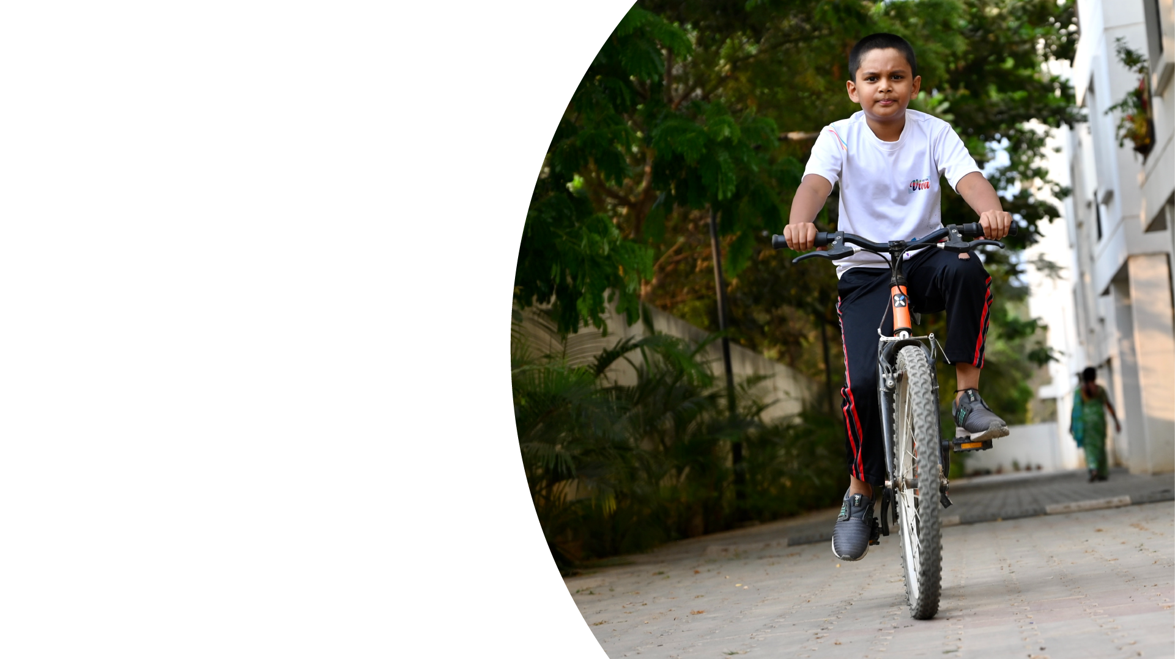
CLIMATE POSITIVE ACTIONS
RIDE A BIKE
Notes:
Riding a bike rather than taking the bus or getting a lift with your parents or guardians

Slide 13
CLIMATE POSITIVE ACTIONS
UNPLUG A CHARGER
Notes:
Unplugging your chargers when you’re not using them

Slide 14
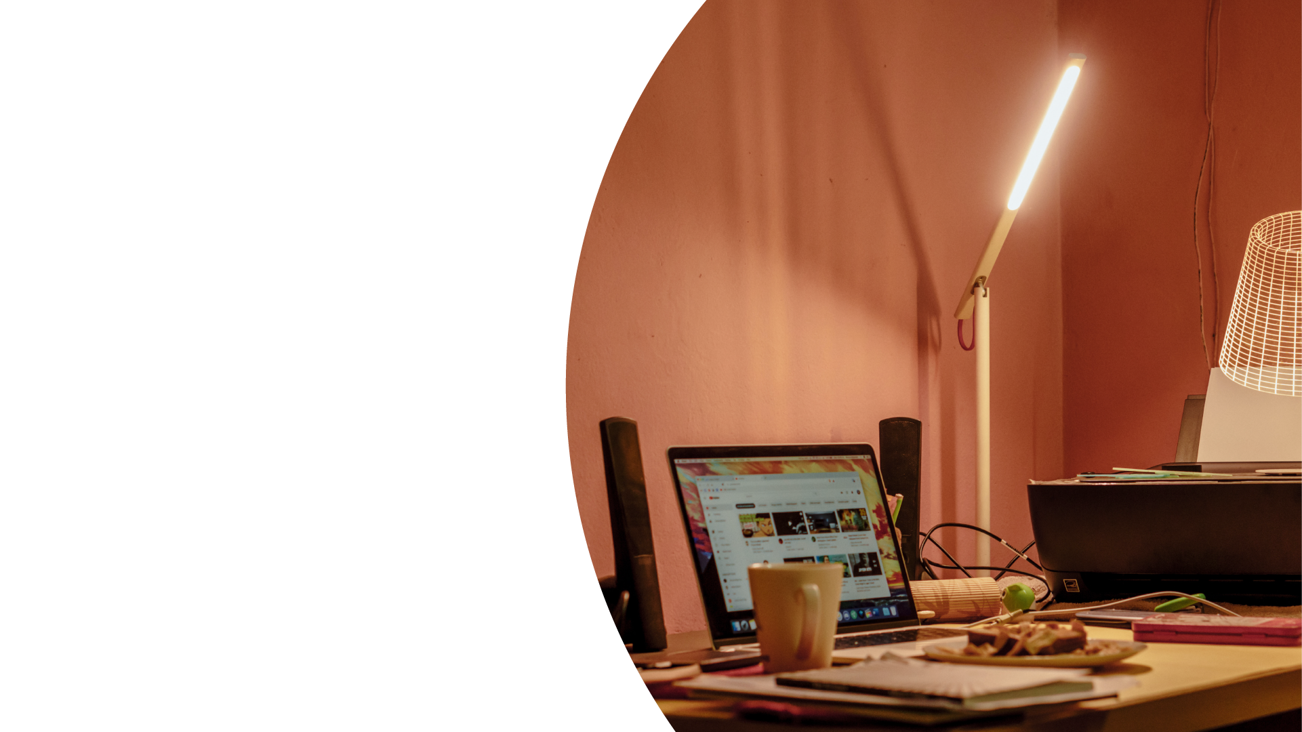
CLIMATE POSITIVE ACTIONS
TURN OFF LIGHTS
Notes:
Turning off the lights when you leave the room

Slide 15
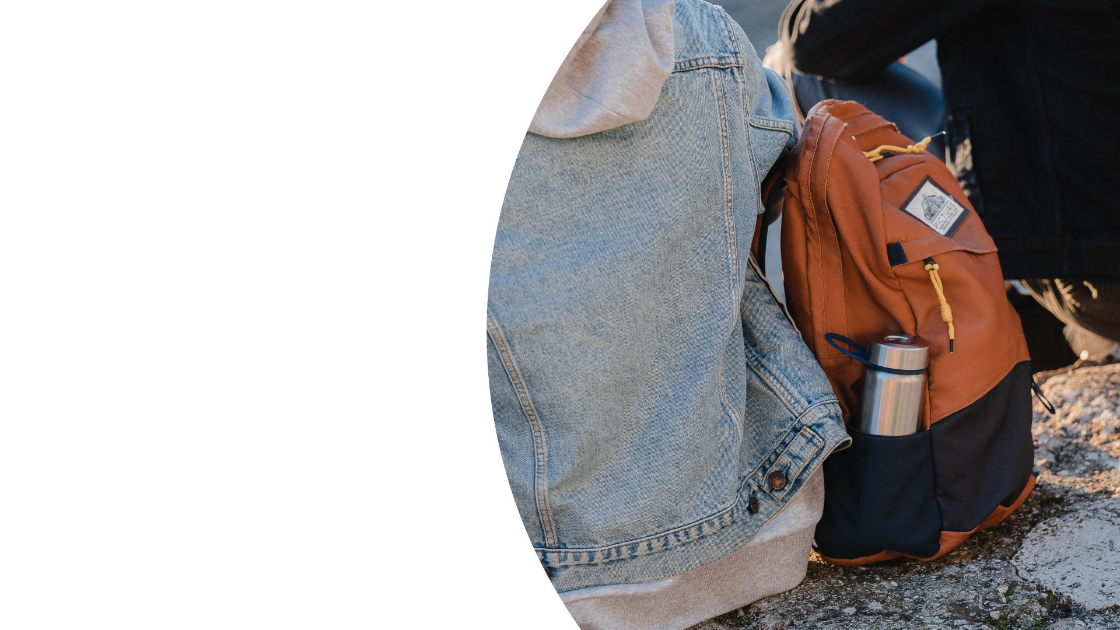
CLIMATE POSITIVE ACTIONS
BRING A REUSABLE WATER BOTTLE
Notes:
You can take a reusable water bottle instead of a plastic one.

Slide 16
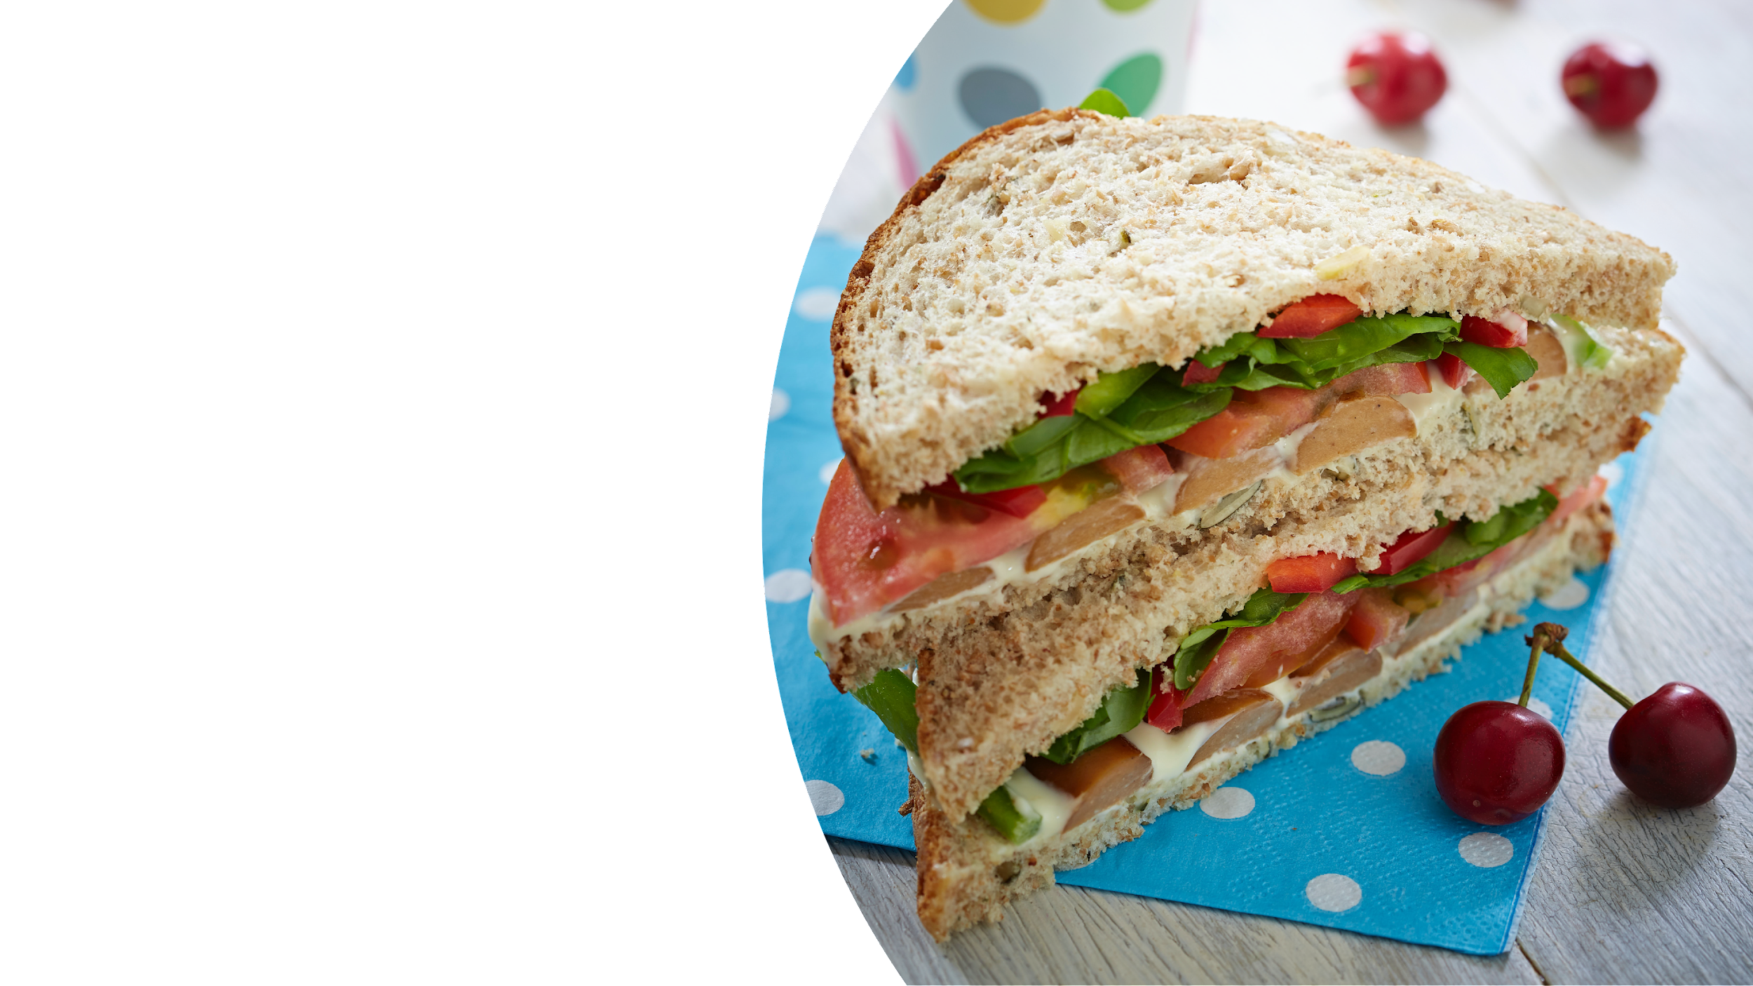
CLIMATE POSITIVE ACTIONS
PACK A NO WASTE LUNCHBOX
Notes:
Why don’t you challenge yourself to pack a no waste lunch box? Avoid plastic wrapping if possible, and only take what you’re going to eat.

Slide 17
CLIMATE POSITIVE ACTIONS
DONATE YOUR CLOTHES, BOOKS, OR TOYS FOR REUSE
Notes:
You can donate things you no longer need to charity for others to reuse.
Share these ideas with other people!

Slide 18
MANY SMALL ACTIONS =
BIG POSITIVE CHANGES
WE CAN ALL BE CLIMATE LEADERS AND GO ONE STEP GREENER, STARTING TODAY!
Notes:
Finally, climate change can be scary, so if you ever want to talk to anyone about it, please let your form teacher know.
Look out for more announcements about COP26 and our school’s Climate Leader plans. There will be lots of opportunities for you all to go one step greener!

